Slide 1
SPARC Phase II Meeting
Award U41NS129514

Slide 2


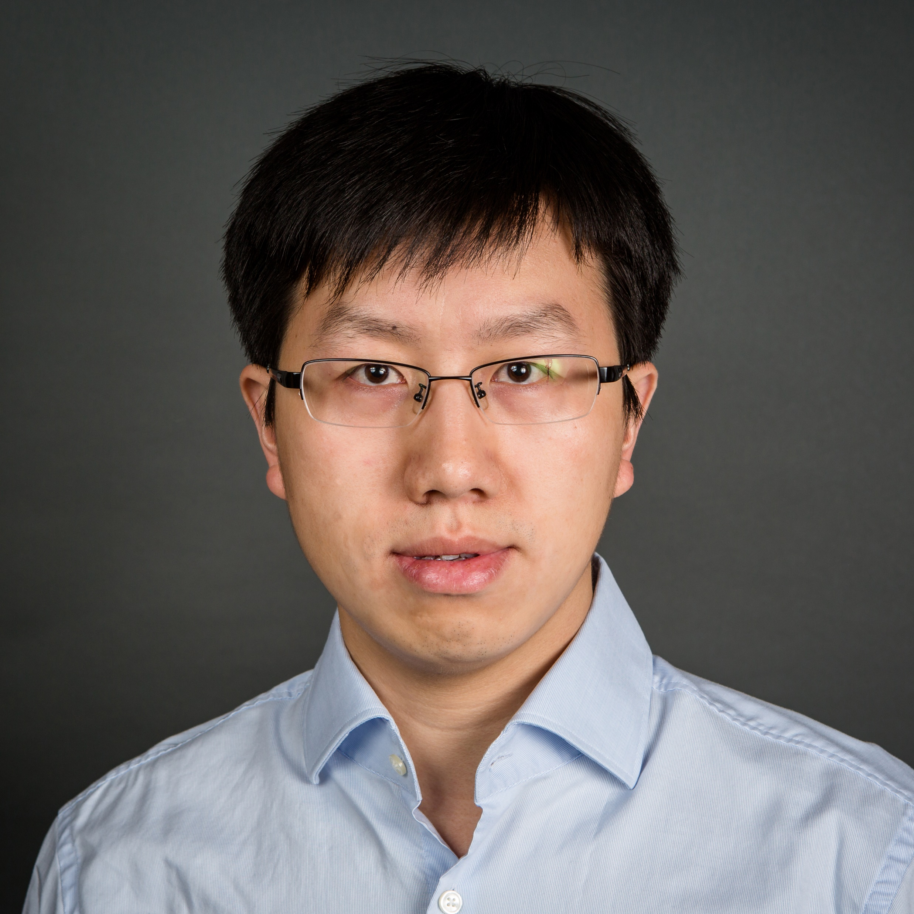
USC Viterbi School of Engineering Team
Ellis Meng
MPI
NEST 4
Polymer cuff
Maral Mousavi
Investigator
NEST 5
Chemical sensor
Hangbo Zhao
Investigator
NEST 5
Mechanical sensor
Brianna Thielen
PhD Student
Quentin Rezard & Alberto Esteban Linares
Postdocs
Farbod Amir Ghasemi
PhD Student
Mona Abdelmonem
Postdoc
Xinghao Huang
PhD Student
Xiangling Li
Postdoc

Slide 3



Industry Partners
Raja Hitti
MPI, Med-Ally LLC
NEST 1&3
Electrodes, leads, mechanical components
Victor Pikov, PhD
MPI, Medipace Inc.
NEST 2
Software and hardware
Jayme Coates
Director of New Product Development
Jared Wells
Manager of New Product Development
Helen Czarniewicz
Director of Regulatory Affairs and Quality Assurance
Focus
Uruguay
CoForce Taiwan
Carroll Biomedical USA
Barabino
Spain
Med-Ally Support Team

Slide 4


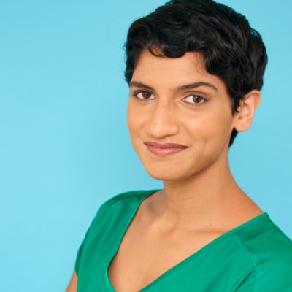
TID and Admin Core
Sahar Elyahoodayan, PhD
USC
Center Director
TID & Admin
Alex Baldwin, PhD
USC
Research Associate
TID
Pallavi Gunalan
USC
Project Admin
Admin

Slide 5
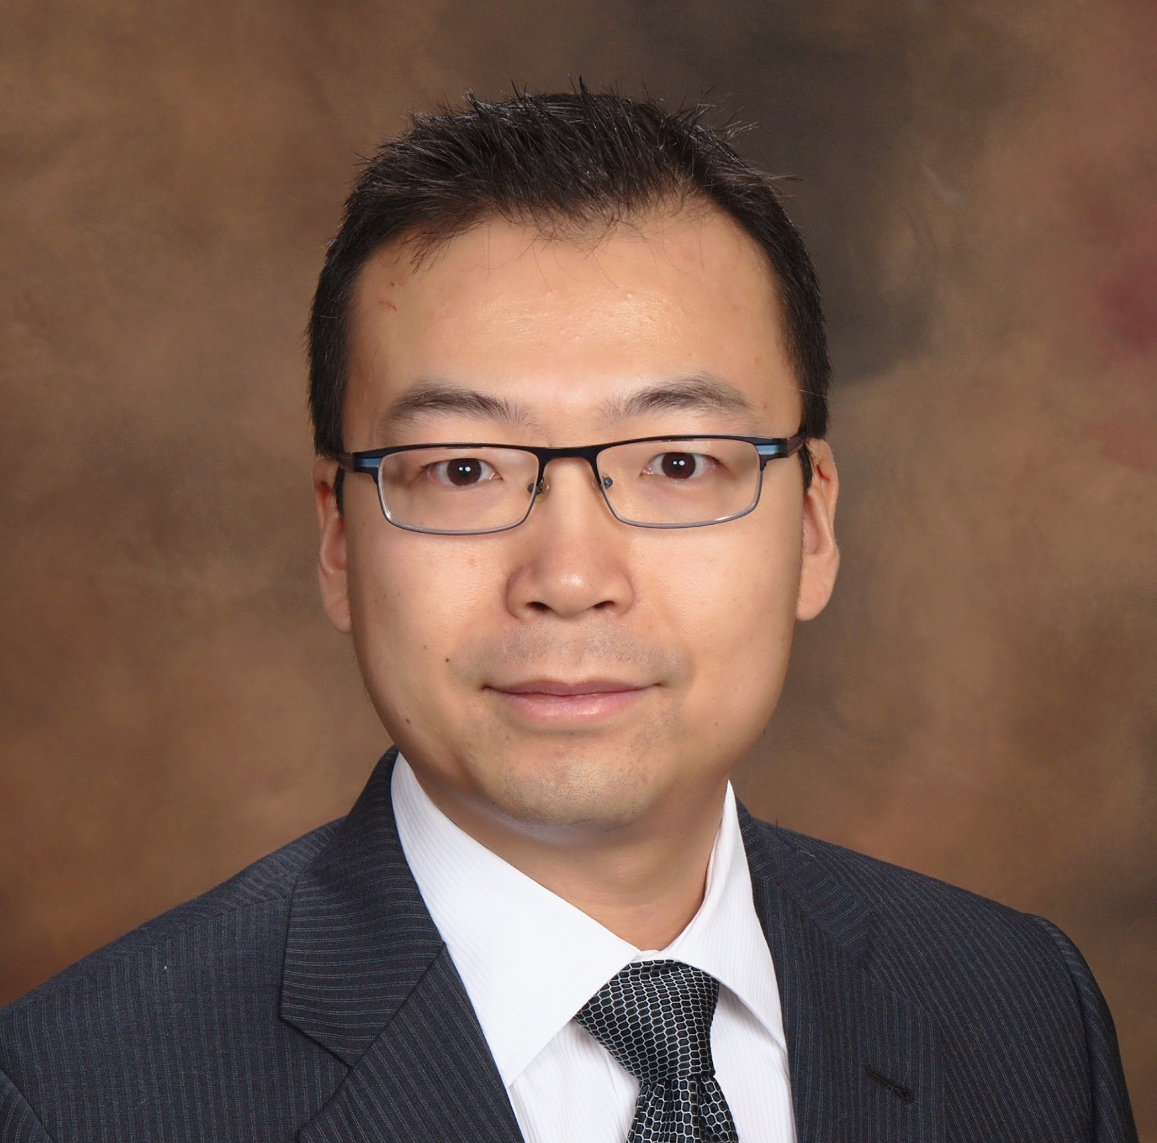


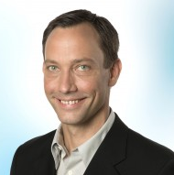
External Advisory Committee
Peng Cong, Ph.D.
UC San Francisco
Electronics for BCI and neuromodulation
Jeanie Park, M.D.
Emory University
Clinical nephrology, sympathetic overactivity
Tracy Cui, Ph.D.
U Pittsburgh
Sensors, neural engineering and interfaces
Martin Schuttler, Ph.D.
CorTec Neuro
Implantable neural interfaces, small cuffs

Slide 6
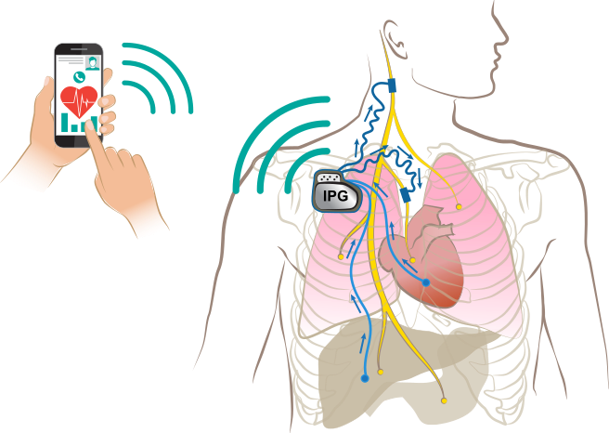
High-Level System Overview
Integrated system
Open- or closed-loop operation
Selectable combination of leads
Common implantable pulse generator (IPG) header and lead connector design
Patient and clinician remote controllers connecting with IPG via Bluetooth
Open-architecture hardware and open-source software
Sharing of documentation and design libraries
Controller
Bluetooth

Slide 7
Overview of all Projects
NEST 3: Assortment of electrodes and leads
Cuff > 1mm
Sacral nerve stim electrode
Electrocardiographic, electromyographic, motion sensing leads
NEST 1: Mechanical
IPG enclosure and header (with connectors, Bluetooth antenna)
Charger
Commercial phone/tablet
NEST 4: Branched nerve stim
Cuff < 1mm
NEST 2: Electrical and Firmware
IPG and controller PCBA: pulse generation, sensing, power management, Bluetooth communications
IPG and controller firmware
NEST 5: Organ sensing
Mechanical and temperature sensing
pH, acetylcholine, and catecholamine sensing

Slide 8
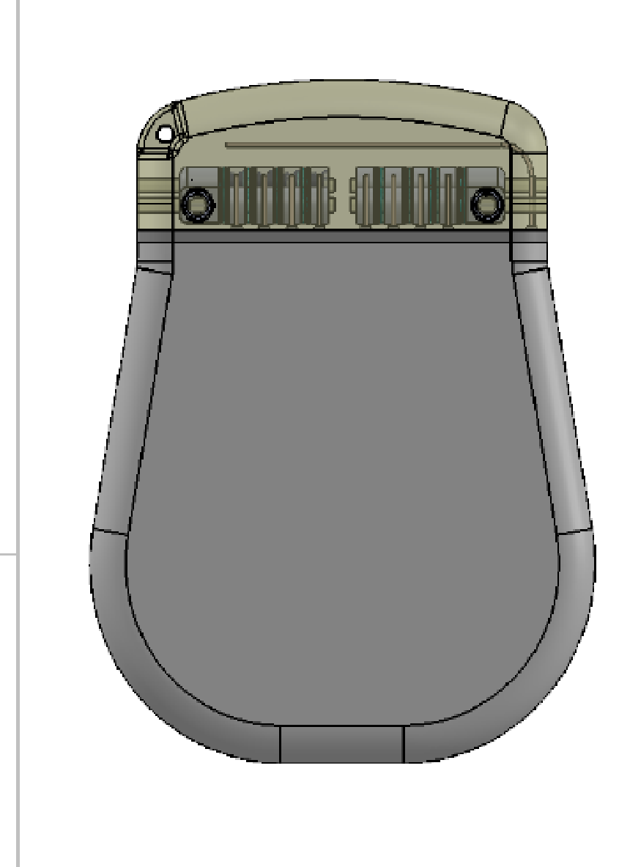
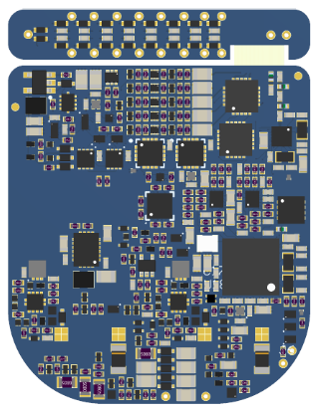
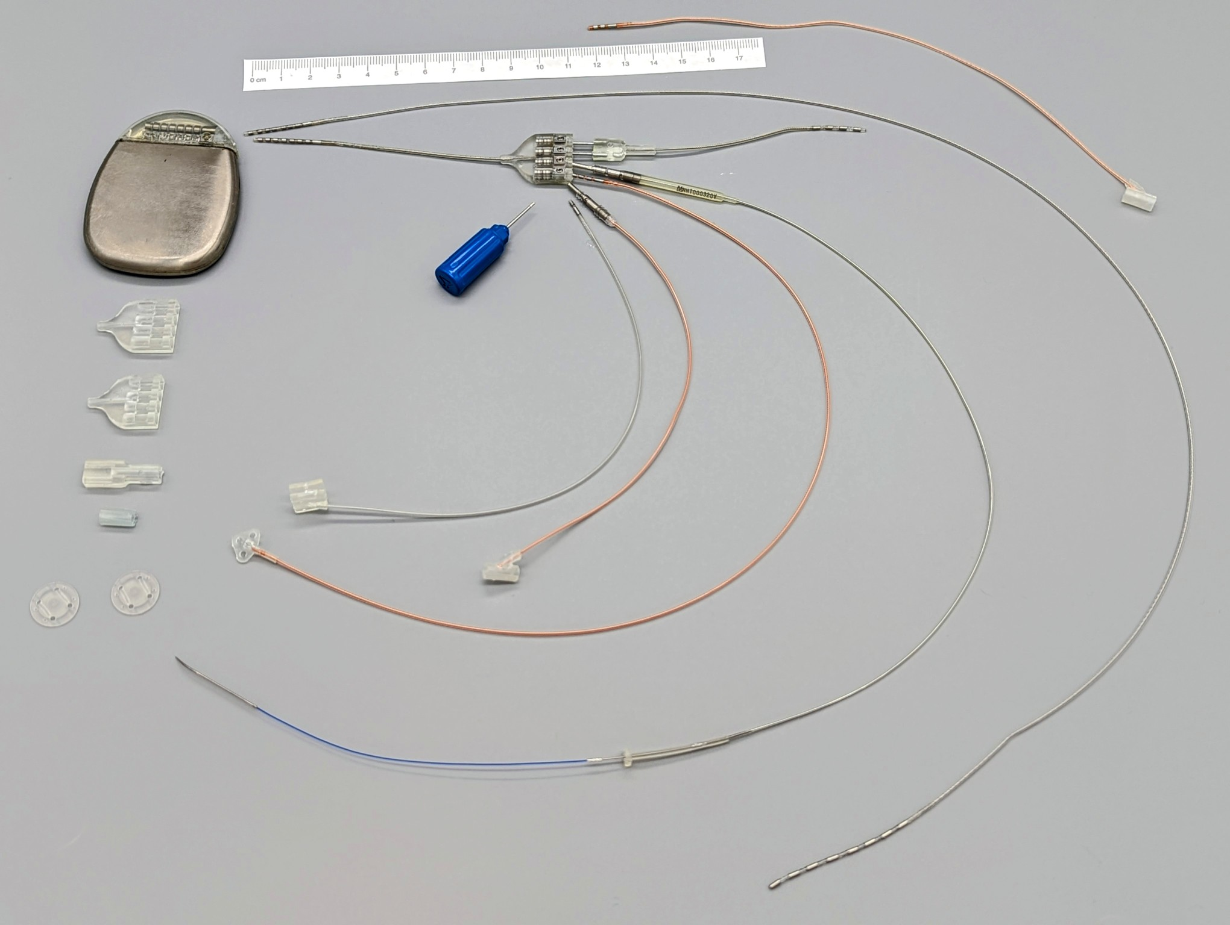
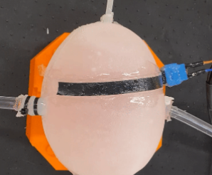
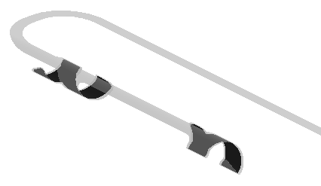
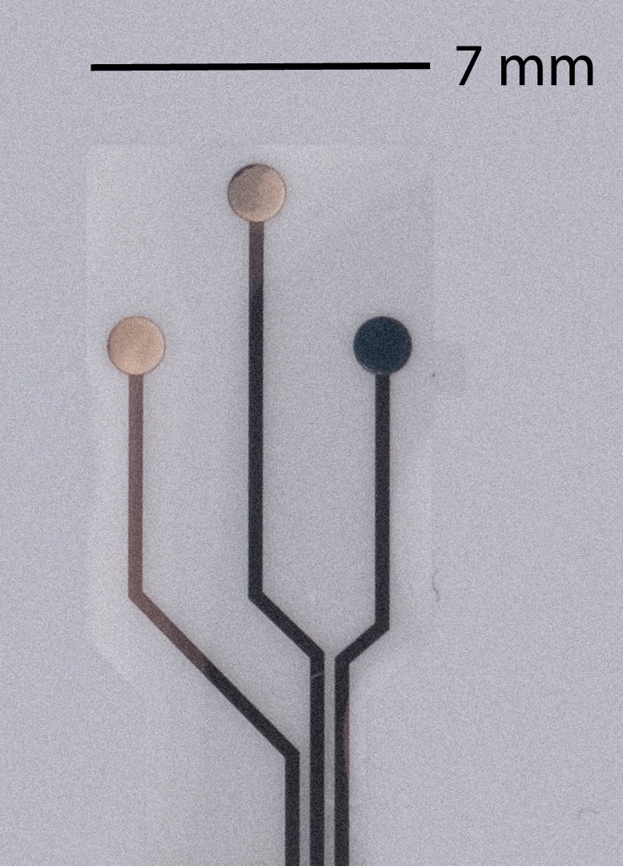
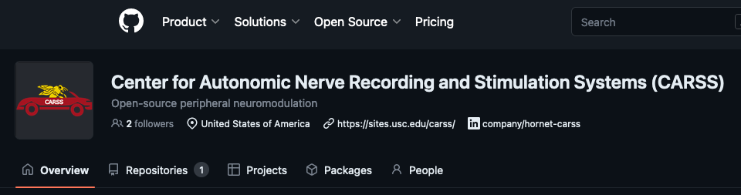
Updates
NEST 1: Mechanical
Completed mechanical design for charger and IPG enclosure
NEST 2: Electrical and Firmware
Completed design documents for the PCBA for the IPG
Drawing, BOM,
schematic, layout
NEST 3: Assortment of electrodes and leads
Completed mechanical design documents for PDMS cuff, SNS, EMG, ECG, and AMS
Component and
assembly specs
Completed test plans and test fixture design
NEST 5: Organ sensing
NEST 4: Branched nerve stim
Developed cuff electrode design options and design selection protocol
Completed initial design and characterization of capacitive strain sensor and resistive temperature sensors
Dissemination
Completed first webinar and GitHub communication channel
Develop plan for validating CARSS components in an animal model
Established open-source licensing conditions
Completed design of 3 electrodes, surface modification, initial in vitro verification of chemical sensors

Slide 9
Opportunities for collaboration
Interconnectivity of sensors and leads across COSMIIC and CARSS components
Clinical collaborators to conduct first-in-human studies
Sustainability and means of creating a user community

Slide 10
Thank you!

